Slide 1
Mini-Project 2
Blood Sample Data Analysis

Slide 2
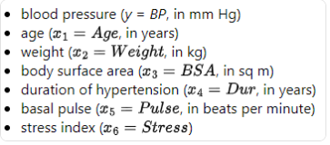
Variables defined

Slide 3
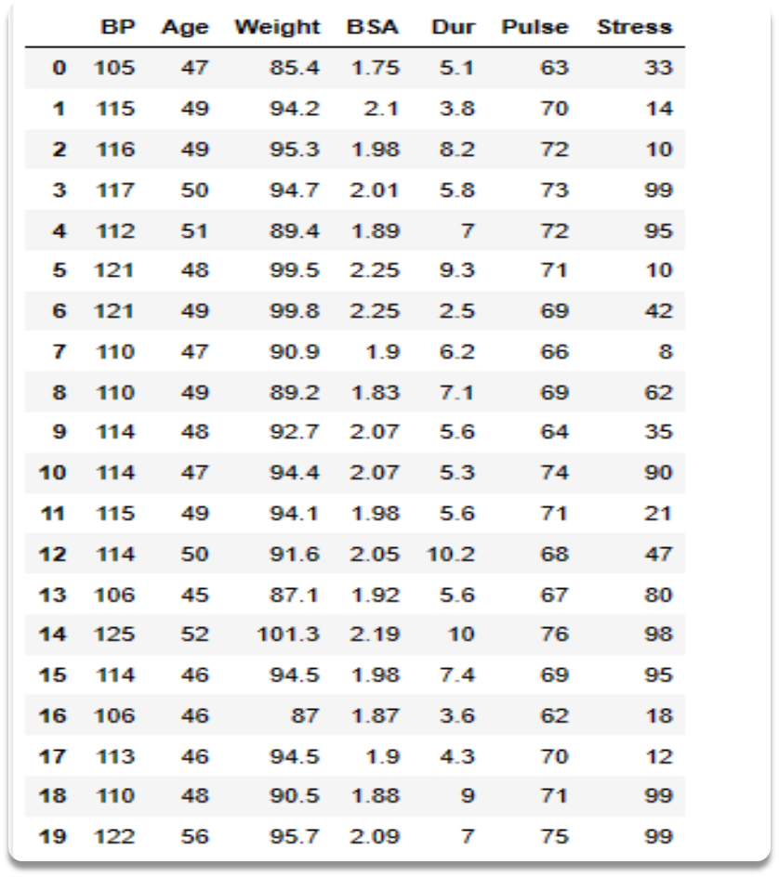
Dataset

Slide 4
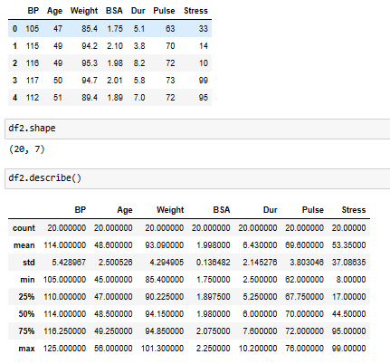
Head, shape and descriptive statistics

Slide 5
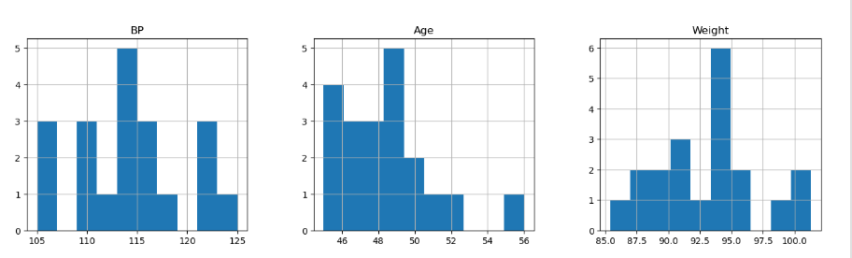
Histograms of ‘BP’, ‘Age’ and ‘Weight’
The sample featured 20 subjects aged 46-56 with high blood pressure (hypertension) scores ranging from 105 mm Hg to 125 mm HG and a weight range from 85.4 - 101.3 kg with an average 0f 94.5 kg.

Slide 6
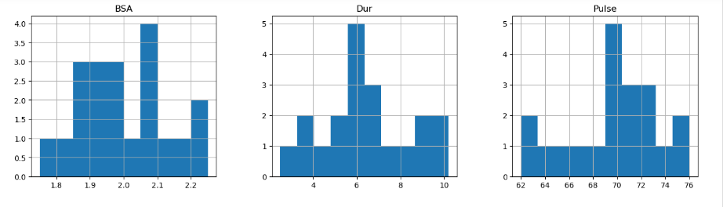
Histograms of ‘BSA’, ‘Dur’ and ‘Pulse’
Duration of hypertension ranged from 1-10 years with more than 2/3 of subjects having theirs last mare than 5 years.
Subjects’ body surface area (BSA) ranged from 1.75 sq m 2.25 sq m, while pulse varied from 62-76 beats per minute,

Slide 7
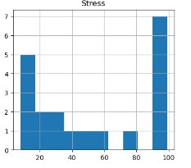
Stress Histogram
Seven participants scored very high for stress with index ratings ranging from 90-99.

Slide 8
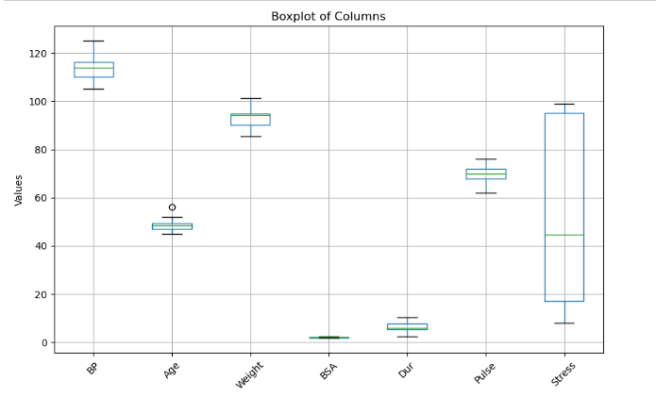
Boxplot
The 'Stress' variable produced boxplot with the most variance 50% of the data (interquartile range) ranging from 17 (25th percentile) and 95 (75th percentile) with a median of 44.5.
The remaining six variables produced considerably smaller scales, the largest of which was 'BP' with an interquartile range of 110 -116.25 with a median of 114.

Slide 9
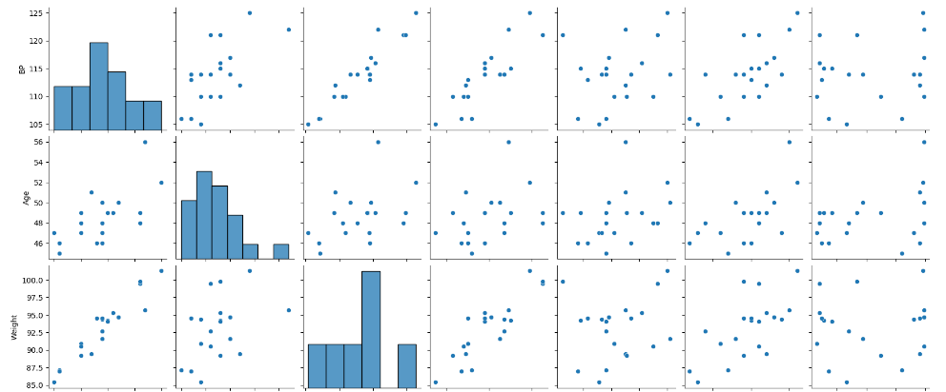
Pairplot

Slide 10
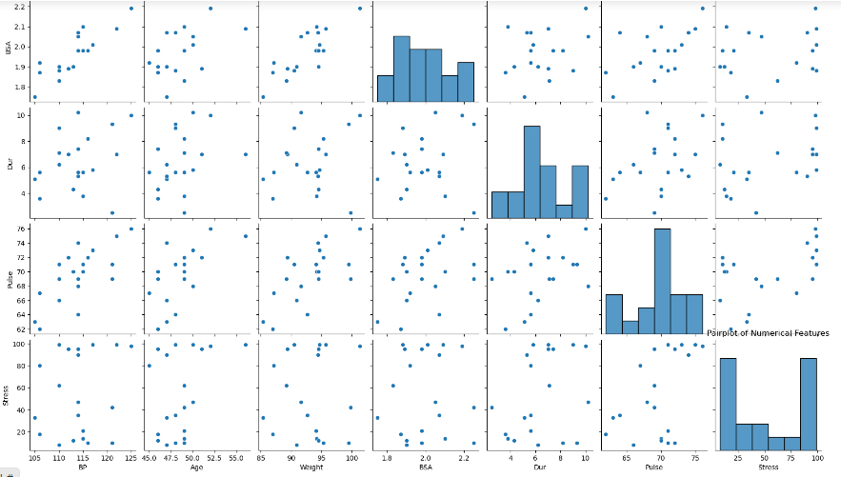
Pairplot (continued)

Slide 11
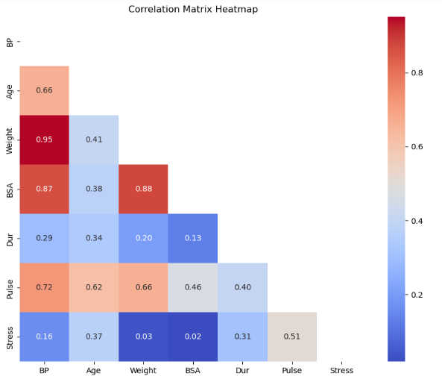
Correlation Heatmap

Slide 12
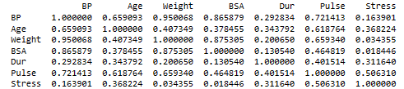
Correlation Matrix
Both the pairplot and correlation matrix both showed significant positive correlations between the target variable ('BP') and predictor variables; 'Age' (r=0.66), 'Pulse' (r=0.72), 'BSA' (r=0.87), and 'Weight' (r=0.95).
Strong correlations were also found between predictor variables such as 'Pulse' and 'Age' (r=0.62), 'Pulse' and 'Weight' (r=0.66), and 'BSA' and 'Weight' (r=0.88).
Collinearity could be affecting target variable as a result of the significant correlations between the predictor variables.

Slide 13
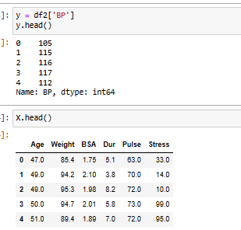
Defining target variable and predictor variables

Slide 14
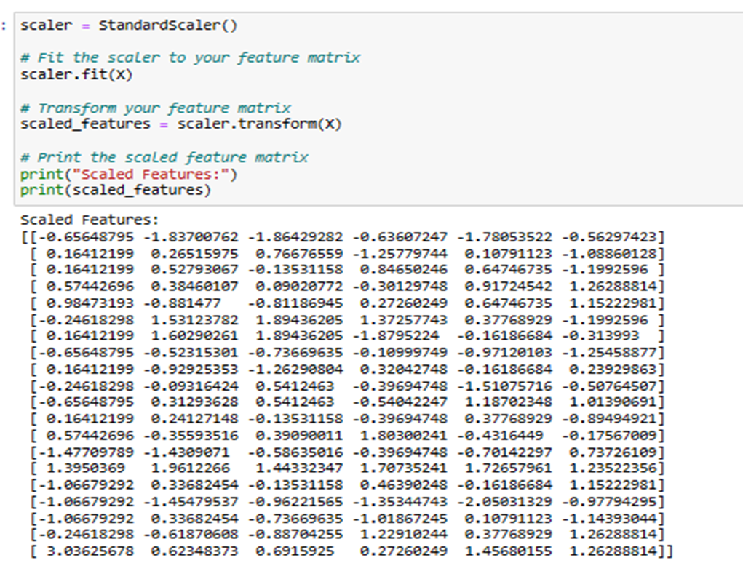
Scaled Features

Slide 15
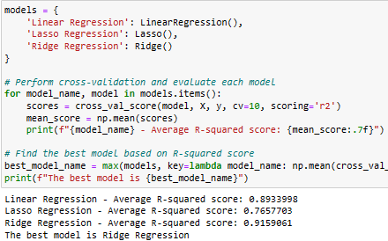
Determining best model

Slide 16
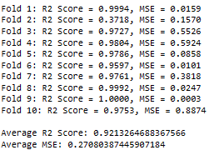
Cross Validation (before standardisation)

Slide 17
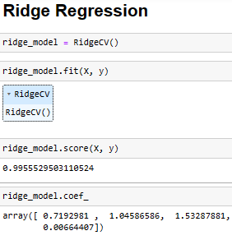
Ridge Regression (before scaling and regularisation)
R2 score states that the model explains 99.55% of the variability in the target variable around its mean.

Slide 18
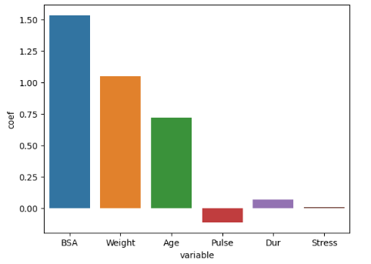
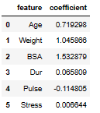
Ridge Coefficients (before standardisation)

Slide 19
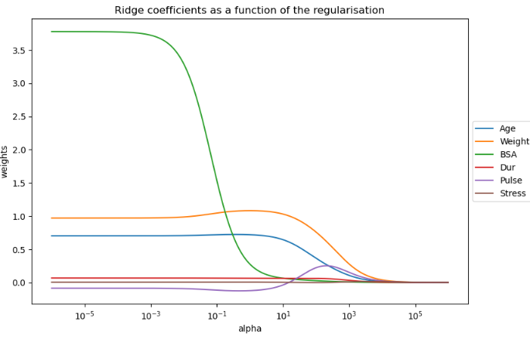
Ridge Regularisation (coefficients)
As alpha value increased, the coefficients of variables eventually decrease to zero.

Slide 20
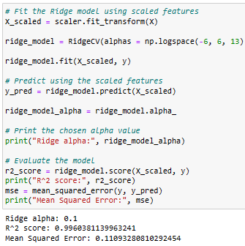
Ridge Regularisation R2 score (scaled)
R2 and MSE scores indicate the model has very high explanatory power and low prediction error.

Slide 21
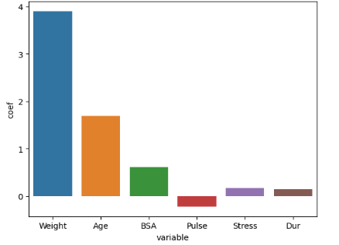
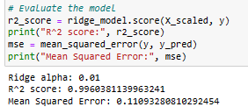
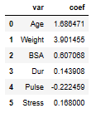
Standardised Ridge Coefficients (alpha = 0.1)
All six predictors contribute coefficients with ‘Weight’ being the most significant followed by ‘Age’ and ‘BSA’.

Slide 22
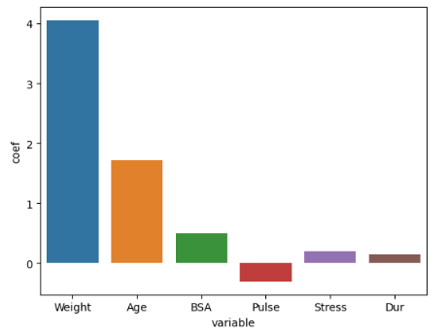
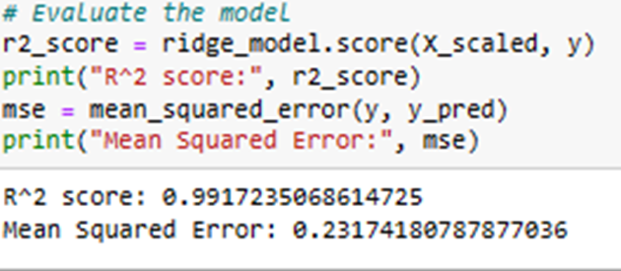
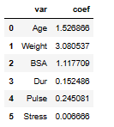
Standardised Ridge Coefficients (alpha 1.0)
All six coefficients still present with marginal decreases.

Slide 23
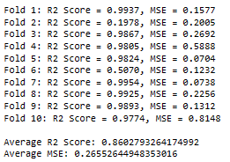
Cross Validation (scaled)
A reduction in R2 score and increase in MSE suggests that the model explains less of the variance in the target variable compared to models without scaling.
Scaling the predictors might not have been beneficial for the model's performance due to underfitting.

Slide 24
END

